Slide 1

EXPLORATORY DATA ANALYSIS PROJECT MOVIE RATING ANALYSIS
Presented by:
Rithiga L
Yamini S
Reshetha M
Tharani S K
Navya Sunil K S
Internship Title: Data Science Intern
Tools Used: Python, Pandas,NumPy Matplotlib, Seaborn

Slide 2

Introduction: Unveiling Movie Insights
This Exploratory Data Analysis (EDA) project aims to understand patterns in movie performance, audience ratings, industry trends, and financial outcomes.
Purpose
Analyze movie performance, ratings, and financial success.
Problem Statement
Identify key factors influencing movie success and audience reception.
Tools & Libraries
Python, Pandas,NumPy Matplotlib, Seaborn.

Slide 3
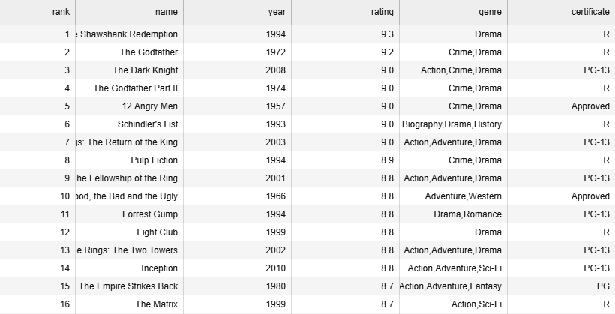
Dataset Overview: Movie Metrics
The dataset contains movie-related features such as: Rating
Budget Run time Writers Genre
Year of release
Director
Data Cleaning :
Data was cleaned and pre-processed to ensure accuracy and consistency for analysis.

Slide 4





Univariate Analysis: Individual Feature Insights
Rating Distribution
Most movies fall within a moderate rating range, indicating balanced audience perception.
Genre Distribution
A few dominant genres show higher production frequency, reflecting industry preferences.
Year-wise Releases
Rising trend over time, especially in recent decades, signifies industry growth.
Top 10 Directors
Identifies prolific filmmakers and their significant influence on content creation.

Slide 5
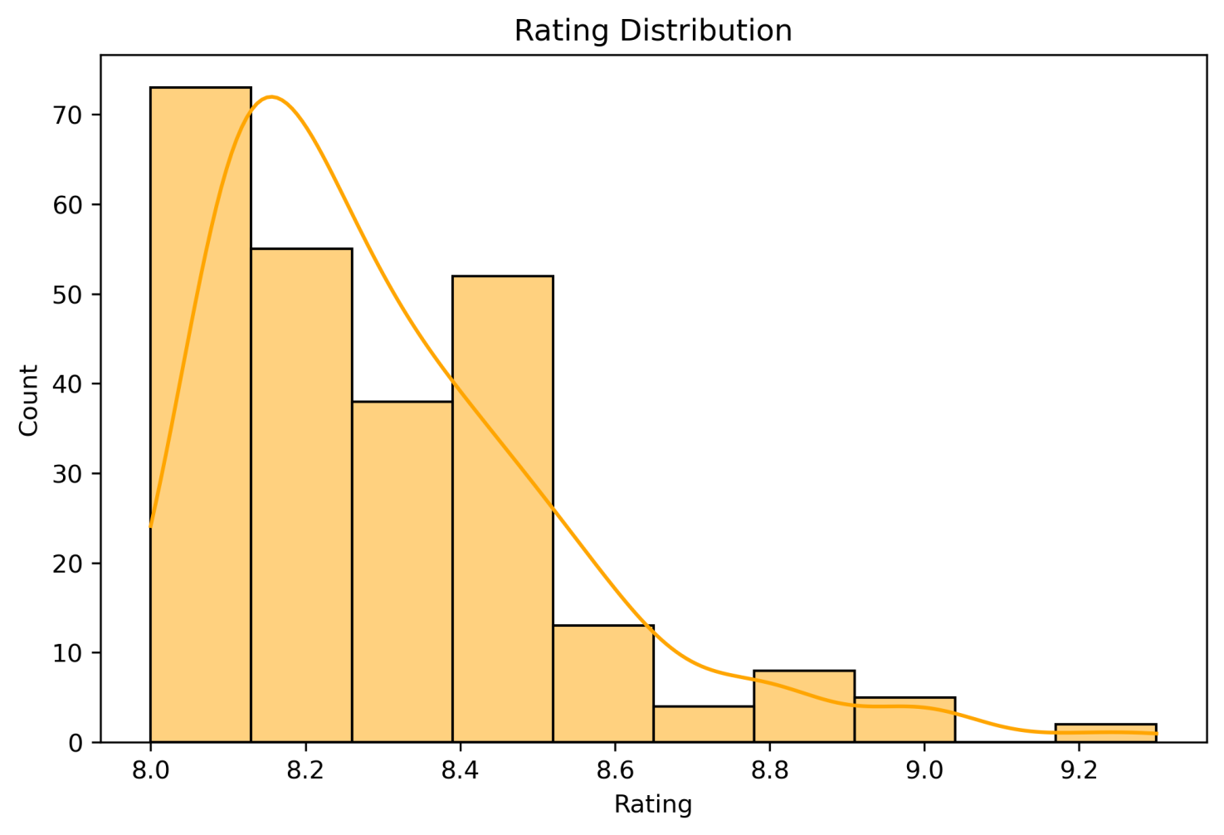
RATING DISTRIBUTION:
.• Most movies lie within a moderate rating range
Very few movies receive extremely low or extremely high ratings .
Indicates balanced audience perception towards most films
plt.figure(figsize=(8,5)) sns.histplot(df_csv['rating'], bins=10, kde=True,color="orange") plt.title("RatingDistribution") plt.xlabel("Rating") plt.ylabel("Count") plt.savefig("Rating_Distribution.png", dpi=300,bbox_inches='tight') plt.show()

Slide 6
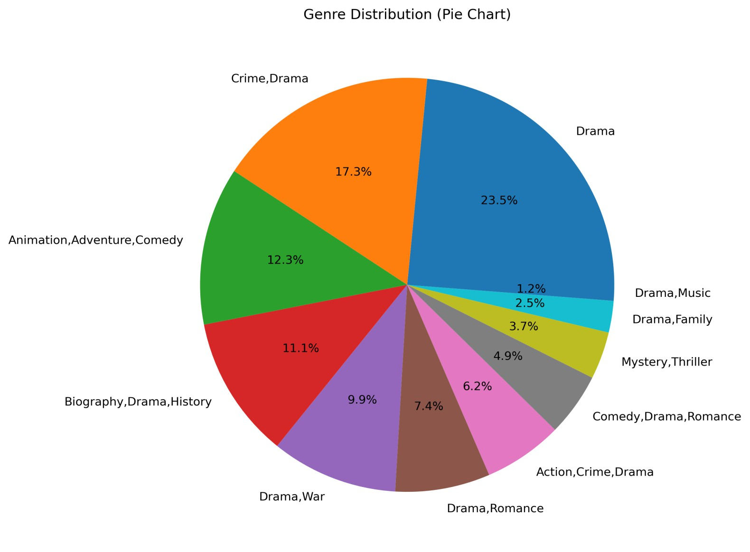
GENRE DISTRIBUTION:
A few genres dominate movie production.
Indicates industry preference for commercially safe and audience-favorite genres.
Shows which genres attract consistent investment
import matplotlib.pyplot as pltimport seaborn as sns plt.figure(figsize=(8,8))df_csv['genre'].value_counts(). drop_duplicates().plot.pie(autopct='%1.1f%%') plt.title("Genre Distribution (Pie Chart)")
plt.ylabel("") plt.savefig("Genre_Distribution.png", dpi=300, bbox_inches='tight')
plt.show()

Slide 7
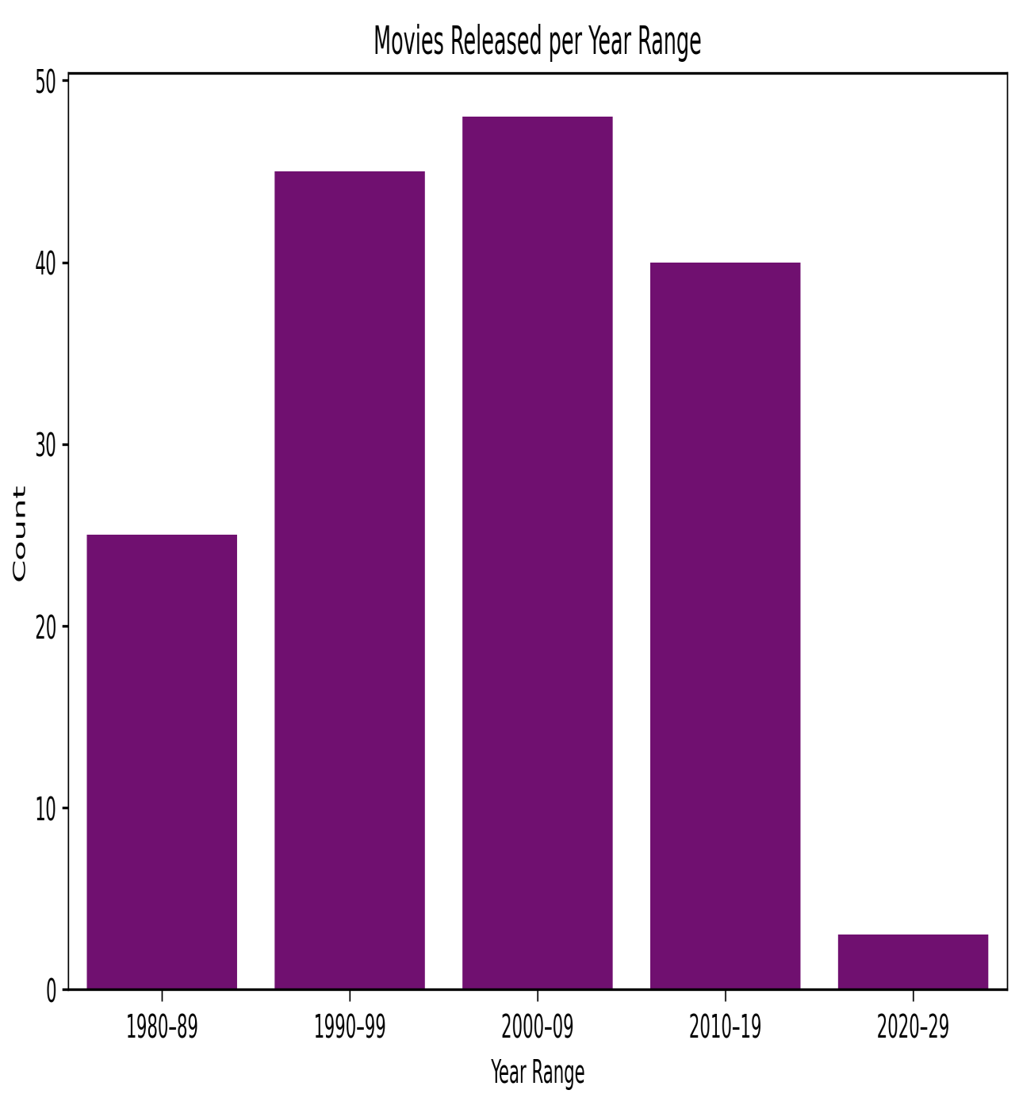
YEAR WISE MOVIE COUNT:
Movie production shows a steady upward trend over the years.
Modern decades indicate higher movie output due an to increased demand.
Reflects expansion of the film industry
bins = [1980, 1990, 2000, 2010, 2020, 2030]labels = ["1980–89",
"1990–99", "2000–09", "2010–19", "2020-29"]
df_csv['year_range'] = pd.cut(df_csv['year'], bins=bins, labels=labels)
plt.figure(figsize=(10,5))
sns.barplot(x=labels,y=df_csv['year_range'].value_counts()[labels],c olor="purple")
plt.title("Movies Released per Year Range“) plt.xlabel("Year Range“) plt.ylabel("Count")
plt.savefig("Movies_Released.png", dpi=300, bbox_inches='tight')
plt.show()

Slide 8
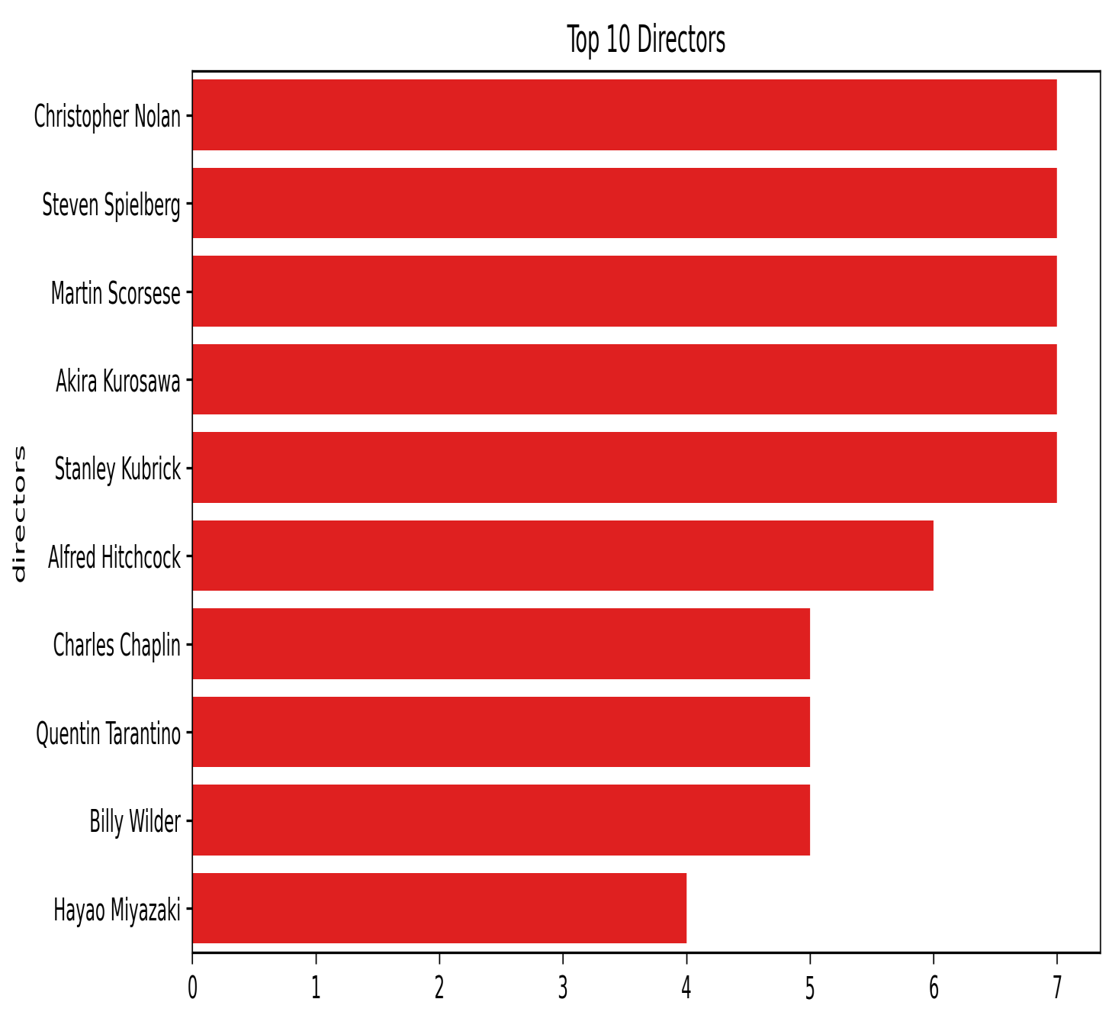
TOP 10 DIRECTORS:
Identifies filmmakers with the highest contribution to the dataset.
Shows how a few prolific directors shape industry output.
Demonstrates director influence on production patterns
plt.figure(figsize=(10,5))top_directors= df_csv['directors'].value_counts().head(10) sns.barplot(x=top_directors.values, y=top_directors.index,color="red") plt.title("Top 10 Directors") plt.savefig("Top_Directors.png", dpi=300, bbox_inches='tight')
plt.show()

Slide 9

Bivariate Analysis: Interconnected Factors
Budget vs. Box Office
A clear positive relationship: higher budgets generally lead to stronger
box-office earnings.
Average Rating Year-wise
Average ratings remain consistent, with a significant upward trend observed between 1960-1980.

Slide 10
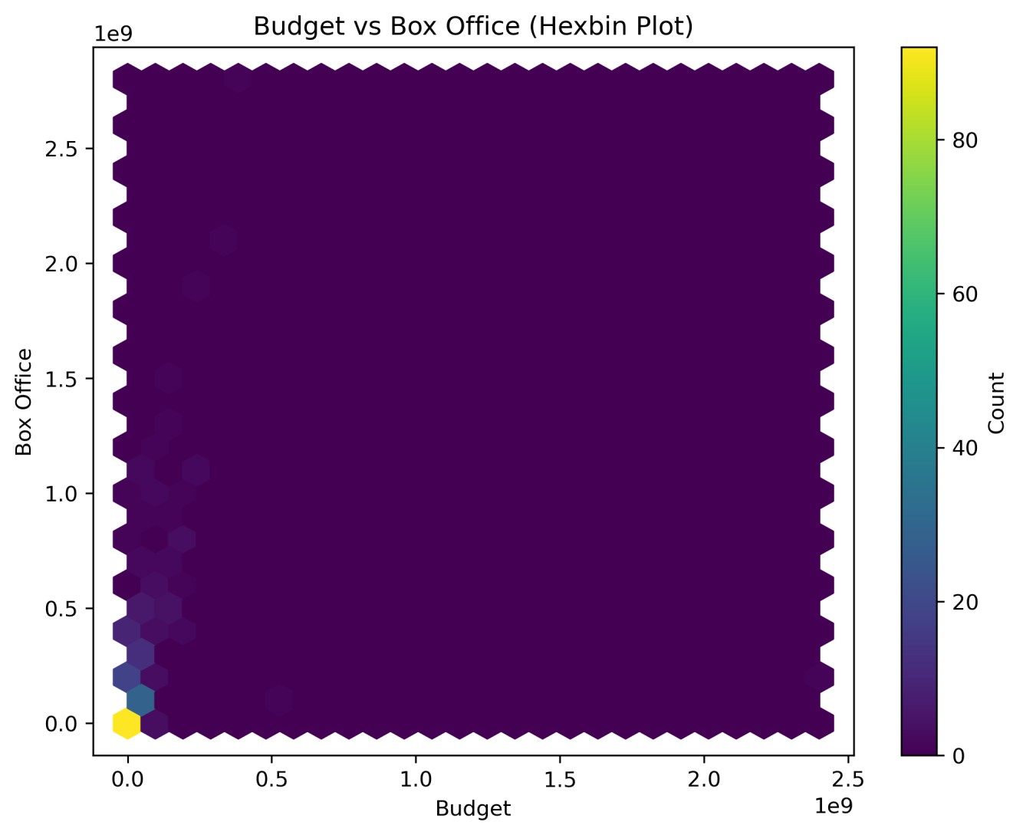
BUDGET VS BOX OFFICE:
A strong positive relationship is seen between budget and box office collections.
Higher-budget films consistently generate higher revenue.
Mid-to-high budget cluster is the densest → common investment zone.
Confirms that investment is a major driver of commercial success.
plt.figure(figsize=(8,6)) plt.hexbin(df_csv['budget'], df_csv['box_office'], gridsize=25)
plt.xlabel("Budget")
plt.ylabel("Box Office")
plt.title("Budget vs Box Office (Hexbin Plot)") plt.colorbar(label='Count') plt.savefig("Budget_Boxoffice.png", dpi=300, bbox_inches='tight')
plt.show()

Slide 11
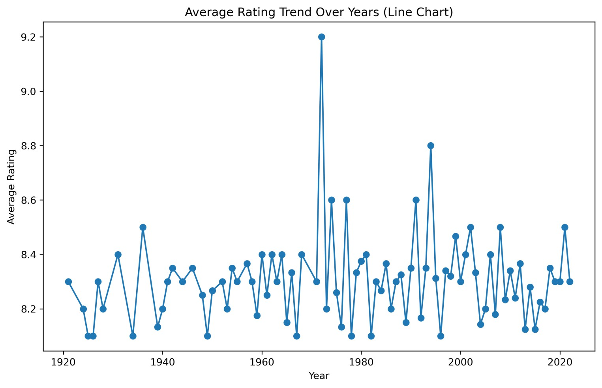
AVERAGE RATING YEAR-WISE:
Average ratings remain fairly stable across years.
A noticeable rise occurs between 1960–1980, suggesting:
Strong storytelling
Unique themes
Indicates that audience standards have remained consistent.
year_rating=df_csv.groupby('year')['rating'].mean()
plt.figure(figsize=(10,6)) plt.plot(year_rating.index,year_rating.values, marker='o')
plt.title("Average Rating Trend Over Years (Line Chart)") plt.xlabel("Year")
plt.ylabel("Average Rating") plt.savefig("Average_Rating.png", dpi=300,
bbox_inches='tight‘)
plt.show()

Slide 12
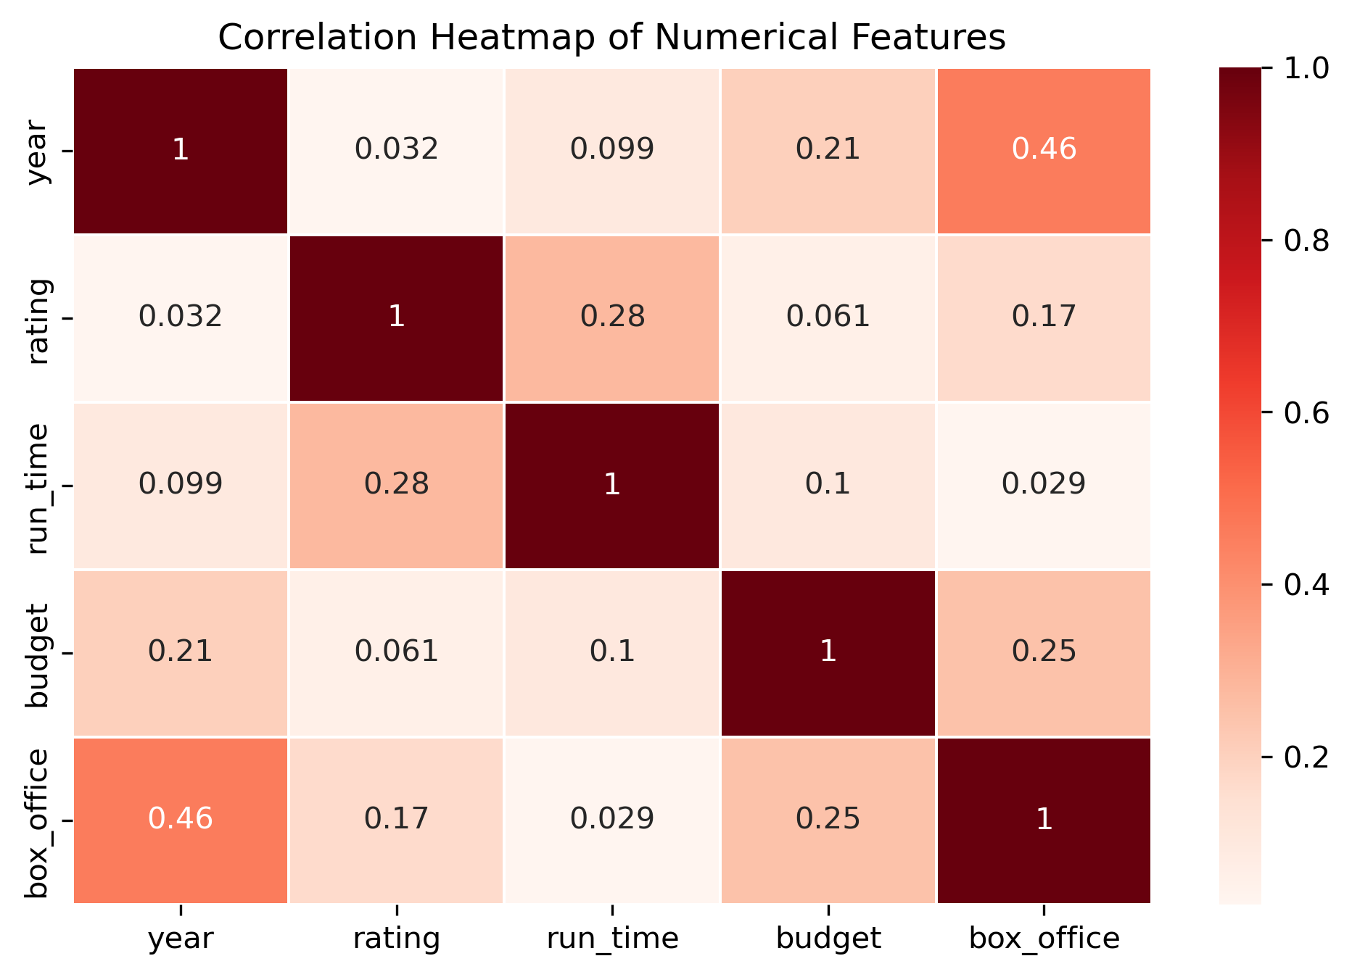
Multivariate Analysis: Correlation Heatmap
Key observations:
Budget & Box Office: Strong positive correlation
Other numerical variables: Very weak
correlation
num_cols = ["year", "rating", "run_time", "budget", "box_office"]
corr = df_csv[num_cols].corr()
plt.figure(figsize=(8, 5))
sns.heatmap(corr, annot=True, cmap="Reds", linewidths=0.5)
plt.title("Correlation Heatmap of Numerical Features") plt.savefig("Correlation.png", dpi=300,
bbox_inches='tight') plt.show()

Slide 13
Key Insights Summary
Ratings & Genres
Moderately distributed ratings; dominant genres reflect audience trends.
Industry Growth
Movie releases increased significantly, indicating industry expansion.
Director Influence
Top directors play a major role in shaping production volume.
Financial Success
Higher budgets drive higher box-office earnings; investment is key.
Audience Expectations
Average ratings remain stable, showing consistent audience reception.
Correlation
Only budget and box office show strong correlation; other relationships are weak.

Slide 14

Conclusion
The EDA reveals predictable trends in both creative and financial aspects of movie-making:
The industry continues to expand steadily.
Audience reception remains consistent across decades.
Budget emerges as the strongest predictor of box-office success.
Genre and experienced directors significantly influence production.
Recommendations:
Based on the analysis:
Invest more in genres with historically strong performance.
Provide higher budgets to projects aiming for strong commercial returns.
Collaborate with experienced and consistent directors.
Track year-wise trends to plan content aligned with audience expectations.

